Slide 1


Online Grant Application
Part 2: Submitting a Grant Application
Notes:
Welcome to Part 2 of our online grant application tutorial. This session covers completing and submitting the grant application.

Slide 2
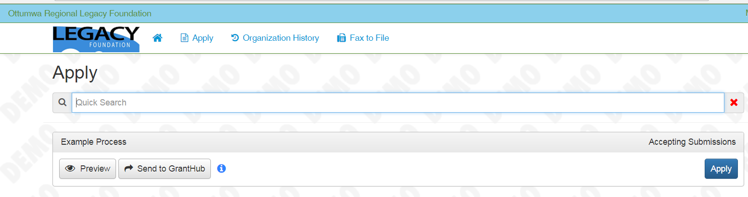
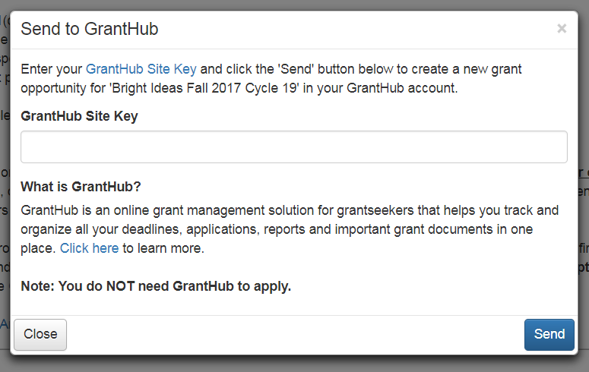
Option 1- Preview grant application
Option 2- Send to GrantHub
…and when you are ready APPLY
Notes:
Log into your user account or return to your “dashboard.”
If the grant cycle is open, the process wil automatically appear on your dashboard
Please NOTE: there may be more than one grant or scholarship process open at the same time- be sure to select the correct process.
There are 2 options prior to starting your grant application. You can preview the application- this is highly recommended so your are prepared with answers and all required supporting documentation. There are also character limits set on many of the text boxes and it is helpful to know these limits before starting your application.

Slide 3
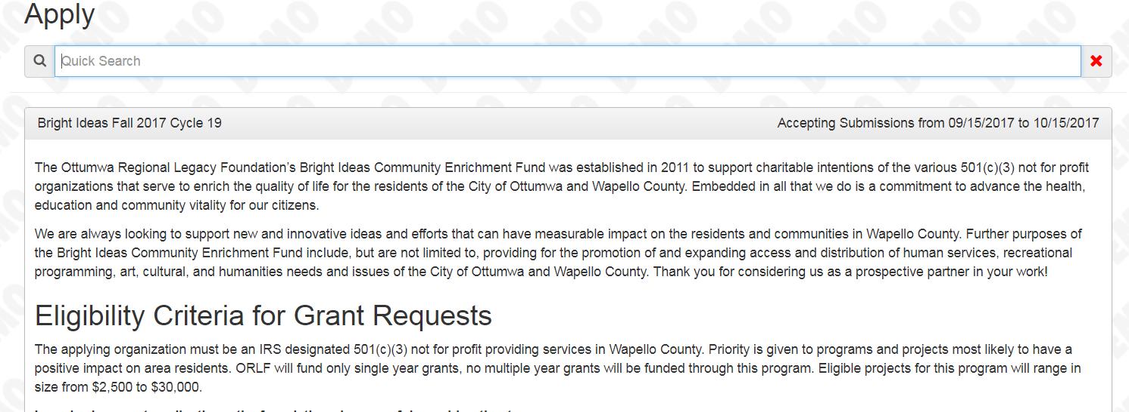
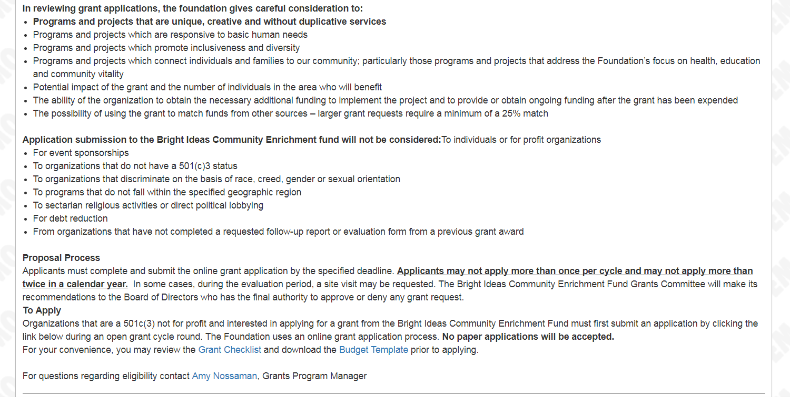
Notes:
Upon entering a grant process, you will see the information page. Confirm again that you are in the correct application process and that your organization and project meet the grant requirements.
On this page you will also find a link to the grant checklist and the budget template. The budget template should be downloaded and saved to your computer to fill out completely with project/program expected income and expenses. You will be required to upload the completed budget in your grant application prior to submission.

Slide 4
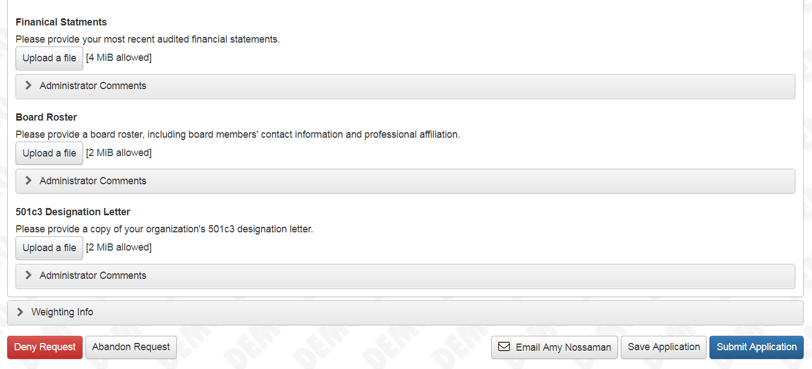
Notes:
If you must exit the application process at any time be sure to click “Save application” prior closing the application

Slide 5
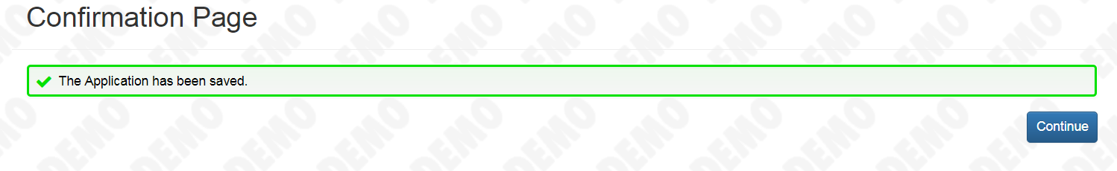
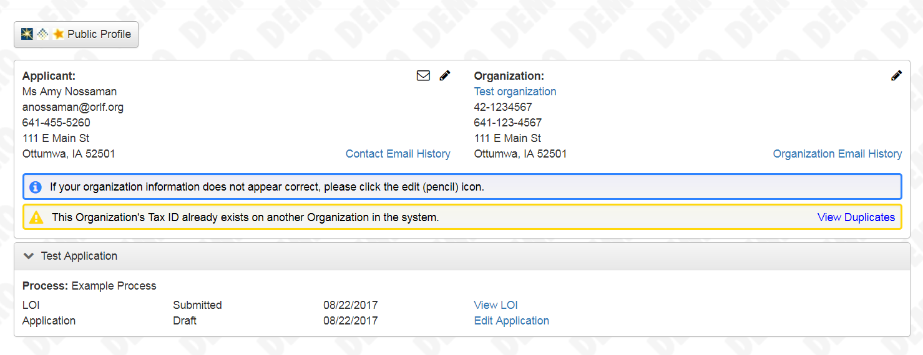
Notes:
You will receive a confirmation email that confirms your application has been saved.
You can reenter your application from your user dashboard.

Slide 6
Notes:
When your application is complete and all required supporting documentation has been uploaded within your application, click the “Submit Application” button

Slide 7
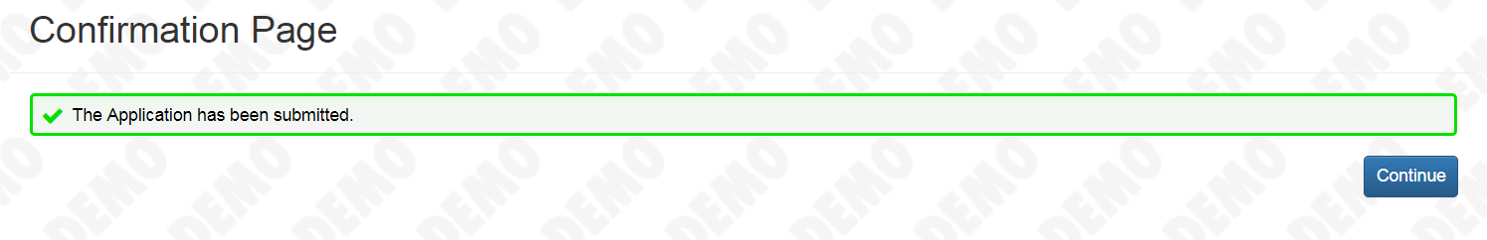
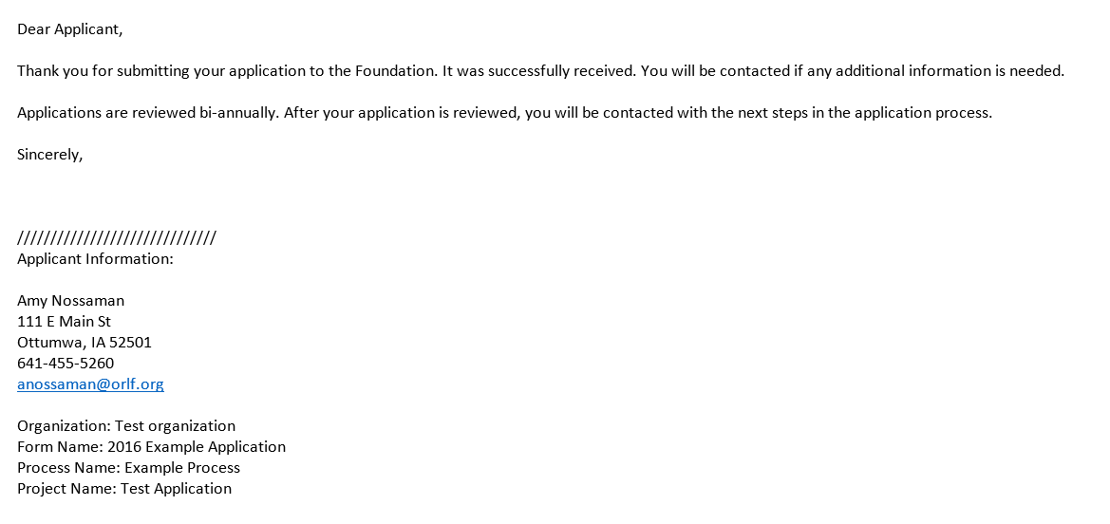
Notes:
You will receive a confirmation email that your application has been successfully submitted.

Slide 8
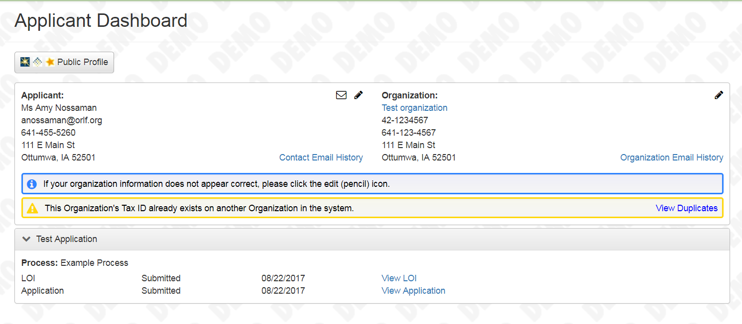
Notes:
Submitted application can no longer be edited but can be viewed at anytime from your user dashboard.
From your applicant dashboard you can also edit your user profile or organization information by clicking on the pencil icon

Slide 9
CONGRATULATIONS!
You have successfully submitted a online grant application.
Additional assistance? Contact Amy Nossaman
Notes:
You have completed the online grants submission tutorial and are ready to go.
Good luck!

