Slide 1
Online Grant Application
Part 1: Creating a Profile
Notes:
Welcome to part 1 of our online grant application tutorial. In this session I will introduce you to our new GMS and show you how to register your organization and create a user profile.

Slide 2
Click on “Create New Account”
Notes:
If this is your first time in our new Grants Management System (9/1/2017) You will need to create a user profile.
If you are not sure whether you or someone in your organization has registered, please do not create a duplicate profile.
Contact Amy Nossaman at 641-455-5260 or anossaman@orlf.org

Slide 3
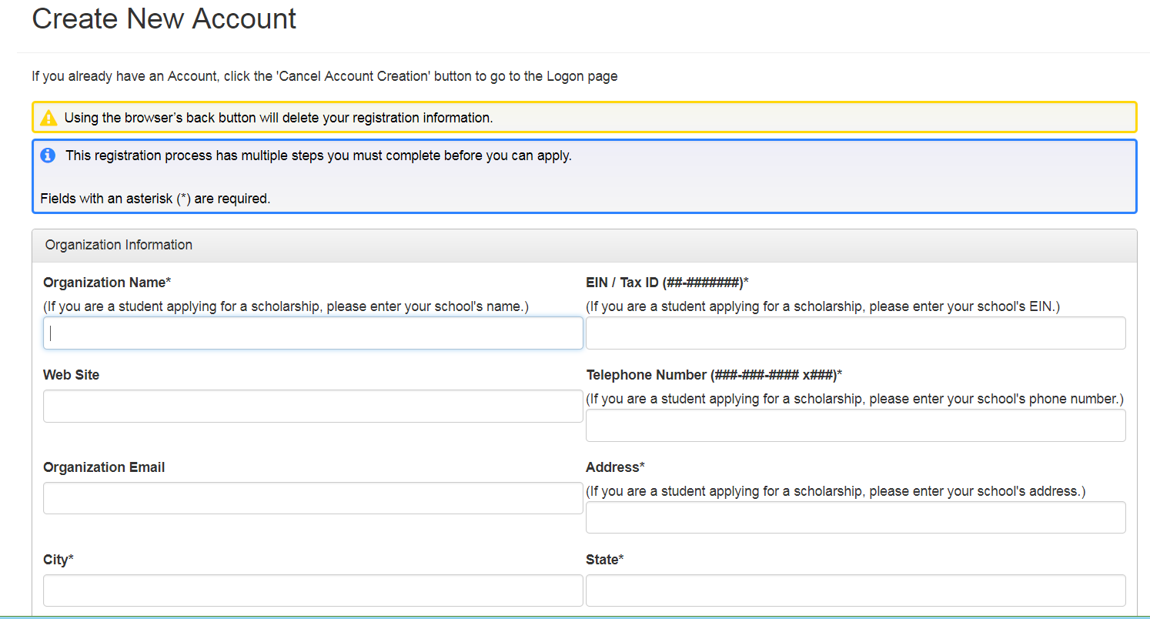
NOTE!
Begin by filling out the following organizational information and click “Next”
Notes:
Begin by filling out the organizational information
PLEASE NOTE: do not use your browser’s back button or it will delete all your registration information and it will have to be entered again.
Click the “Next” button

Slide 4
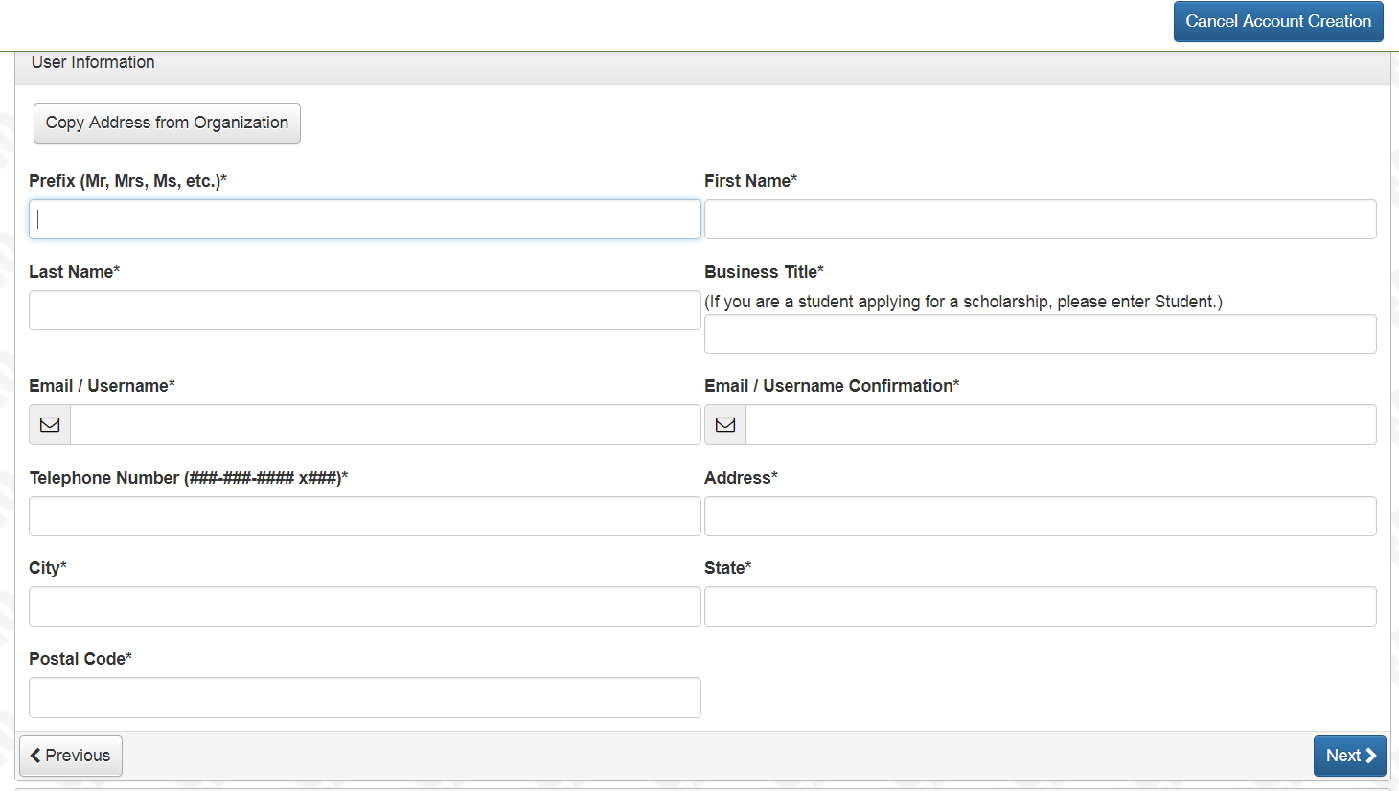
Enter your information
NOTE:
Your email address is your user name and is how we will communicate with you, please use an email address that is checked on a regular basis.
Enter your organization’s address or use “Copy” button and then click “Next”
NOTE: If you get the message
The Login you have entered (your email address) is already in use. Cancel your account creation and contact Amy Nossaman @ 641-455-5260 or anossaman@orlf.org
Notes:
Here is where you will enter your user information. Enter your office address, not your home address OR click the “Copy address from Organization” button in the upper left hand corner of the screen.
NOTE: if you get the popup message that the Login you entered…
This means your email address is already active in the system. Cancel Account Creation and contact Amy Nossaman or go back to the login page and click on “Forgot my password” and you will receive an email link to change your password.

Slide 5
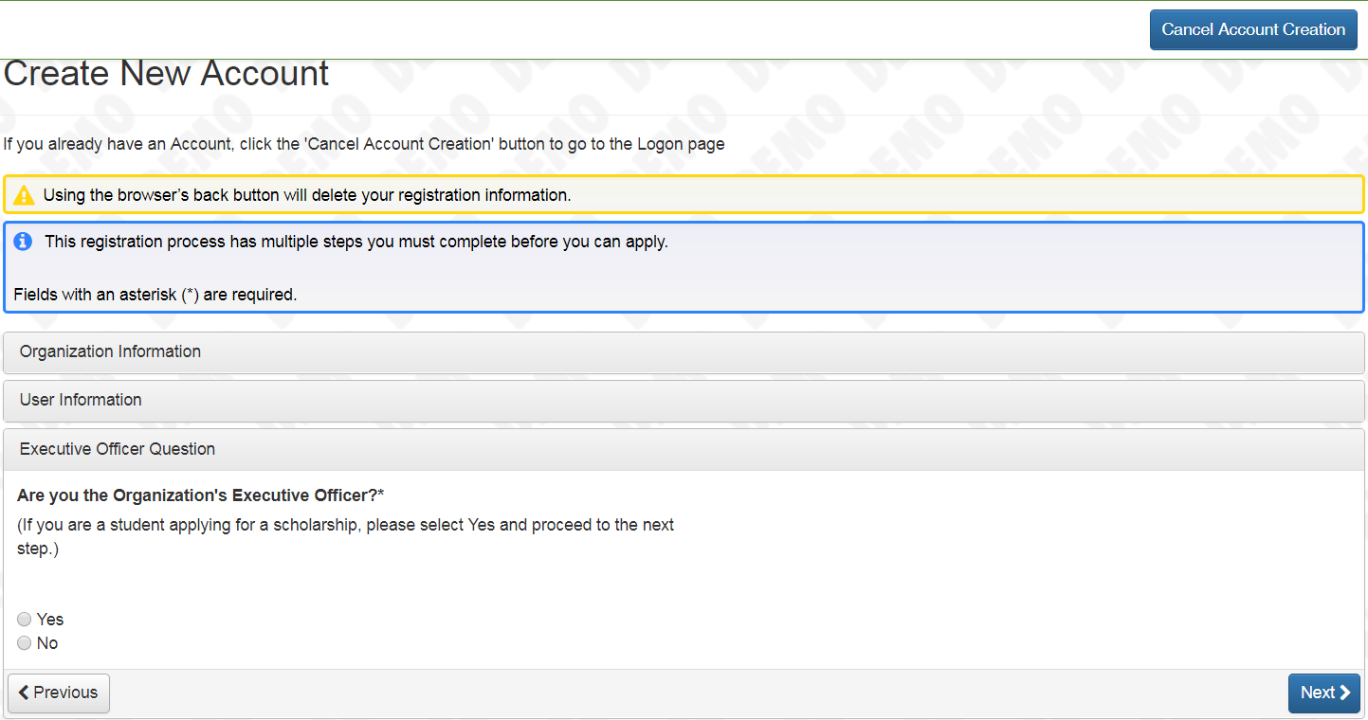
Answer the Executive Office Question. If you answer “No” you will be prompted to enter the contact information for your organization’s Executive Officer
Notes:
Once you click next, you will be asked if you are the Executive Office of your Organization. If yes, click next to move to the next screen. If no, you will need to fill in contact information for the Exec. Officer of your organization.

Slide 6
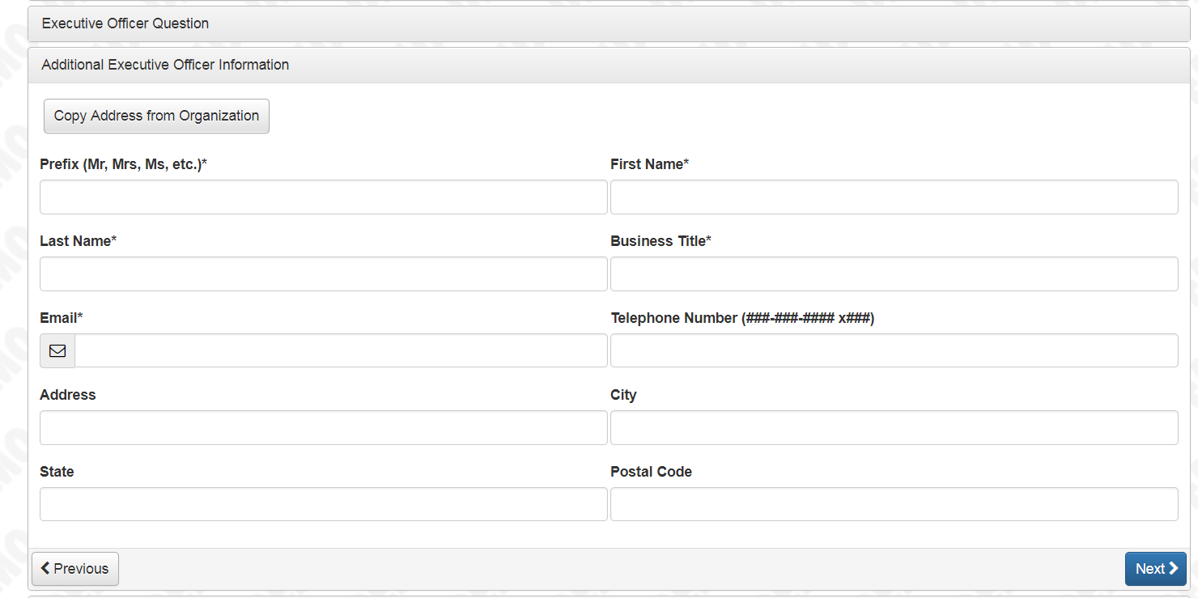
Enter the contact information for the Executive Officer of your organization and click Next
Notes:
Enter your contact information. All cells with an * are required.

Slide 7
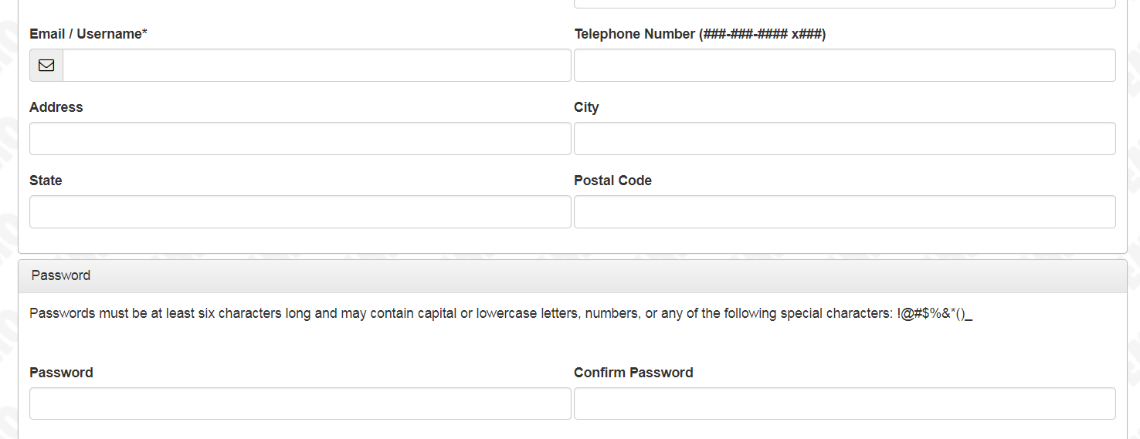
Enter Password
Notes:
To complete your registration as a user, enter a password.
Your password must be
- at least 6 characters long
-many contain upper and/or lower case
letters
Numbers
- and any of the above listed special
characters

Slide 8
Notes:
Confirm your password and click on “Create Account”
You should receive a confirmation email from ORLF, make sure to check your junk or spam folders before you resend the email.
When you successfully receive your confirmation email click continue

Slide 9
CONGRATULATIONS!
You have completed just set up your organization and created your profile.
If you have technical difficulty or additional questions contact Amy Nossaman
Notes:
And you have completed your user profile and are ready to move to the grant application.

